Slide 1

Telehealth and Rural
Healthcare Delivery
When?
Initial Presentation
Rural healthcare
Telehealth at Cone Health
Minute Clinic Access
Inhibitors to more rapid expansion
Major Disruptor?
Ascension Health Case Study
Scott Mason, SKM Enterprises
Joyce Hunter, TBM Council
Phil Cooke, Telesis Partners
Kristine Henderson, Ascension
Presented to Health TechNet
12/14/2018

Slide 2
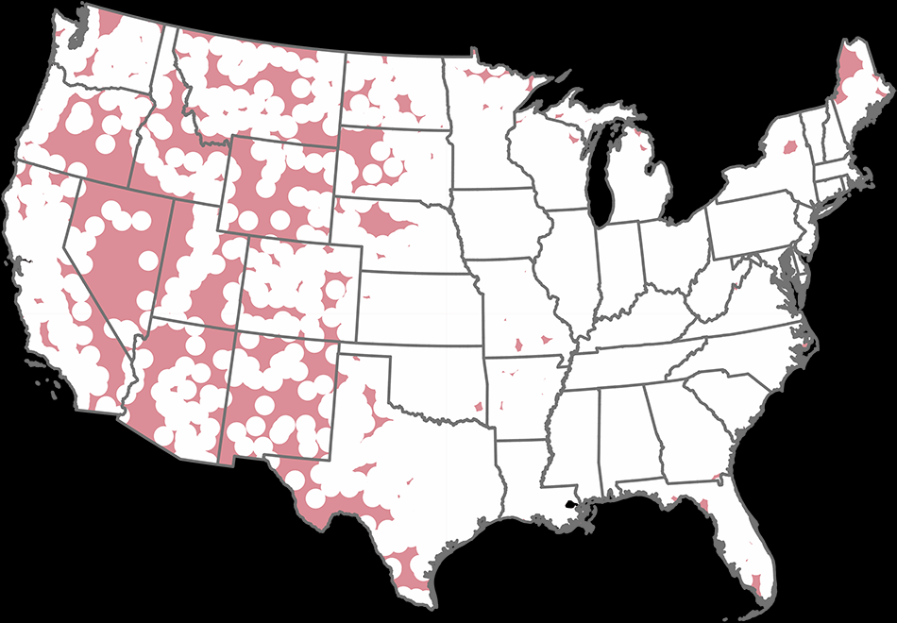


Medical Deserts
Rural Health Market Characteristics
Less dense, aging, and declining populations (19% of the US population lives in rural areas, down from 21% in 2000)¹
Decreasing healthcare workforce and provider supply (13 physicians per 10,000 people compared to 33 physicians in metro areas)²
High reliance on government payors (an average rural hospital’s payor mix is 61% government payors)³
1 HRSA.
Rural Health Information Hub.
HFMA.
30 million Americans don't live within an hour of trauma care
The rate of accidental deaths is nearly 50% higher in rural versus urban areas

Slide 3
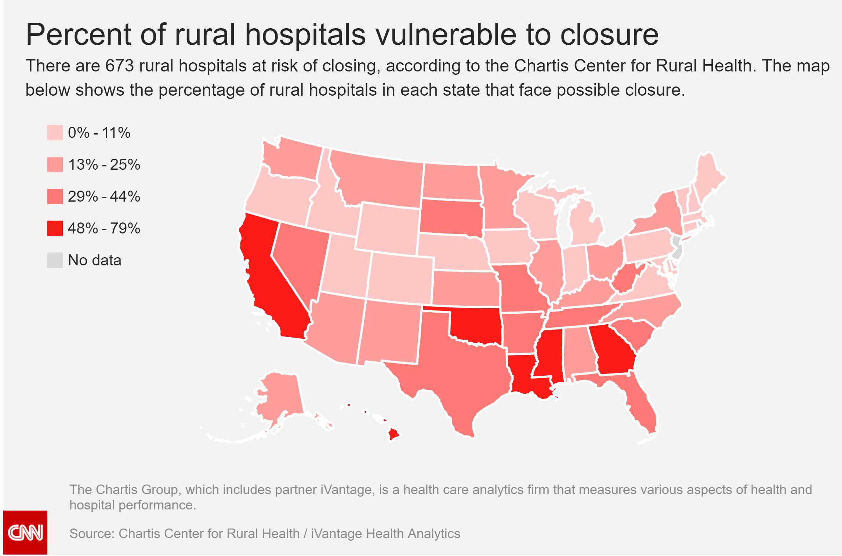
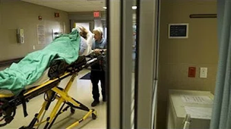
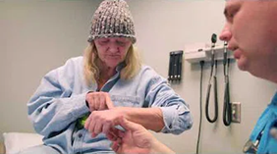
Rural Hospital Closures are at epidemic levels.
Health Care in America: Insurance Gaps and Medical Deserts
WSJ
Telehealth Links Rural Utah
Intermountain Healthcare

Slide 4
Rural health depends on two things under ACA: critical access hospitals and telehealth.
What
Why?
Critical Access Hospitals
Telehealth
CAHs are paid for most inpatient and outpatient services to Medicare patients at 101 percent of reasonable costs.
CAHs are not subject to the Inpatient Prospective Payment System (IPPS) or the Hospital Outpatient Prospective Payment System (OPPS).
Critical-access hospitals, which have 25 beds or fewer, saw 14 closings in 10 states last year. Hospitals in three states switched designation from prospective payment systems to critical-access, bringing the total loss to 11. Overall, there are 1,321 critical-access hospitals in the country in 2014, down from 1,332 in 2013.
Today, telehealth encompasses four distinct domains of applications. Note, however, that each state Medicaid program and private insurer varies in its use and reimbursement of these applications. These are commonly known as:
Live Videoconferencing (Synchronous) — Live, two-way interaction between a person and a provider using audiovisual telecommunications technology.
Store-and-Forward (Asynchronous) — Transmission of recorded health history through an electronic communications system to a practitioner, usually a specialist, who uses the information to evaluate the case or render a service outside of a real-time or live interaction.
Remote Patient Monitoring (RPM) — Personal health and medical data collection from an individual in one location via electronic communication technologies, which is transmitted to a provider in a different location for use in care and related support.
Mobile Health (mHealth) — Health care and public health practice and education supported by mobile communication devices such as cell phones, tablet computers, and PDAs. Applications can range from targeted text messages that promote healthy behavior to wide-scale alerts about disease outbreaks, to name a few examples.
Source: https://youtube/5vvmfyHfoJg
Estimated to Reach $19.5B by 2025
Source: Healthcare Informatics, by Heather Landi April 2, 2018 reported by Transparency Market Research

Slide 5

The Potential Benefits of Telehealth Seem Almost Unlimited But…
Potential Benefits
Existing Barriers
Improve access to care, especially in rural or urban areas with scarce health care resources
Will enable new models of care to emerge
Play a significant role in the competition for market share and will create new opportunities for innovation
Potential synergies related to combination of health and consumer data
Reduced cost of specialty services
Ability to monitor care remotely (e.g. heart failure)
Regulatory
Political
Cost
Reimbursement
Technical issues (e.g. telecoms)
Bad actors…
Telehealth has the potential to be a major disruptor!
Notes:
Reduced cost of specialty services (episode-of-care costs of $82 per patient per month less than those sent directly for a face-to-face visit)

Slide 6

Early successes
Applications
  Mental Health consults and tele-SUD
  Dermatology (business model)
  ER specialty referrals
  Teleradiology
  Remote monitoring (e.g ICUs)
  Other?
Users
  Primary care practices (PCMH; one-stop care)
  FQHCs
  Emergency rooms
  Intensive Care Units
  Imaging Centers
  Convenient care centers/urgent care (e.g. Minute Clinic)
  Other?
Notes:
SUD= Substance Use Disorder. Limited use among very vulnerable group to date but high potential.

Slide 7
Myths of Telehealth
Gone are the days of having to go to each doctor to collect paper copies of your health charts to take to a different doctor or specialist; records are now interactive and collaborative – even allowing you to access your data on a smartphone or personal computer.
Factoids:
2017 82% of consumers responded they do not use telehealth
80 million Americans use a wearable device (eMarketer)
90% of healthcare executives say they are expanding or developing telemedicine services
Cloudbreak currently performing 90,000 encounters per month in over 800 hospitals nationwide
Telehealth is a video Call Between Me and My Physician from Home or Work (B2C).
All of My Physician Team is Local When I am in the Hospital.
Telemedicine is a Video Encounter Only.
Becker’s Health IT & CIO Report
Jamey Edwards, CEO
Cloudbreak Health
Published 11/20/2018
Notes:
Video Call:
One of the largest behind-the-scenes benefits of telemedicine is consultations between providers who may be great distances apart or even just a town over. Physician B2B2C
Physician Team is Local:
Your doctor is most likely reading your test results in real time on a screen from their office while you’re across town in the scanner. Telehealth and video enable quicker diagnostics and therefore quicker medical action to get you healthy again
Video encounter only:
American Telemedicine Association definition of telemedicine is “the remote delivery of health care services and clinical information using telecommunications technology.”

Slide 8
A Geographic Snapshot of Telehealth Opportunity — Improving but Not Perfect
The American Telemedicine Association conducted a study on telehealth coverage and reimbursement using indicators such as scope of service, eligibility, technology requirement, and arbitrary conditions of payment.
Top Six
New Hampshire
Maine
Virginia
Tennessee
New Mexico
Washington, D.C.
Bottom Two
Connecticut
Rhode Island

Slide 9
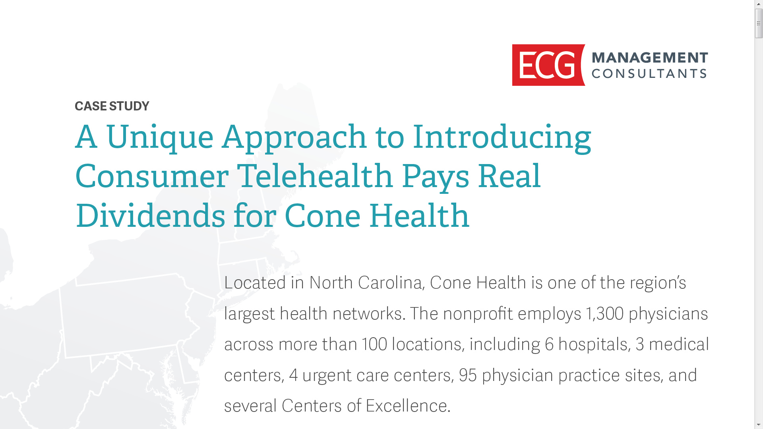
Cone Health: a Telehealth Case Study

Slide 10
Key steps in implementing effective telehealth strategy.
Identifying a simple point of entry into telehealth
Creating work groups to represent impacted organizational stakeholders
Building clinical support for the new delivery model
Piloting with a small, yet representative, patient population of Cone Health employees
Designing an effective marketing and communications plan

Slide 11
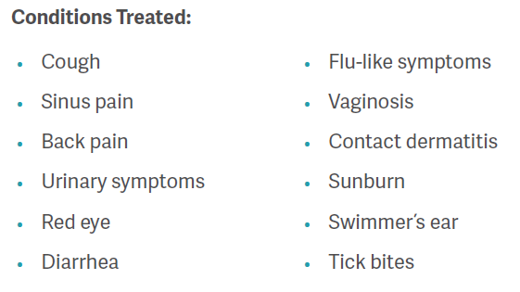
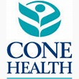
User interface

Slide 12
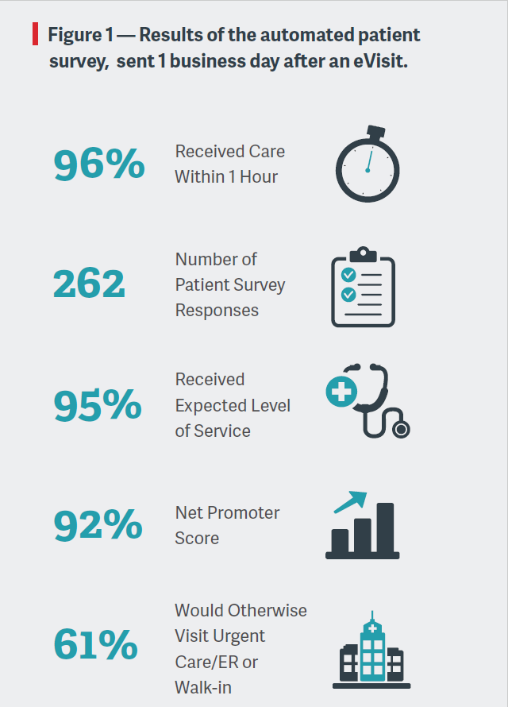
Telehealth Cone Health Case Study:
Early results.

Slide 13
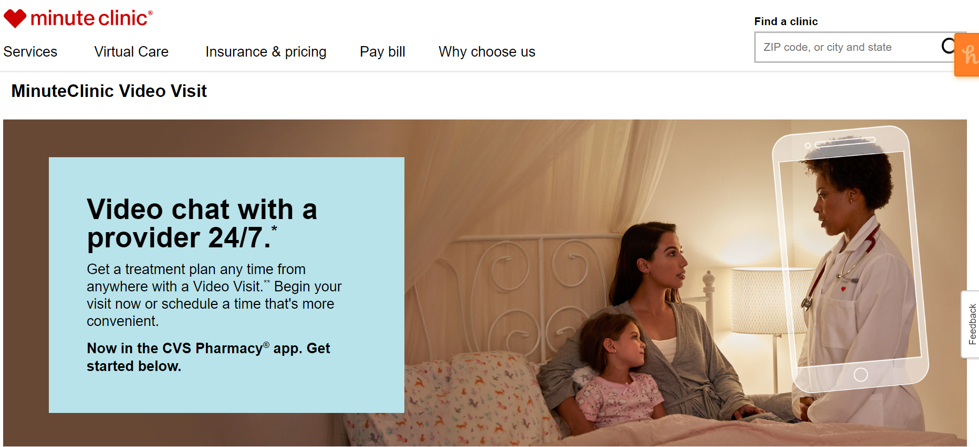
Watch for Convenient Care Centers

Slide 14
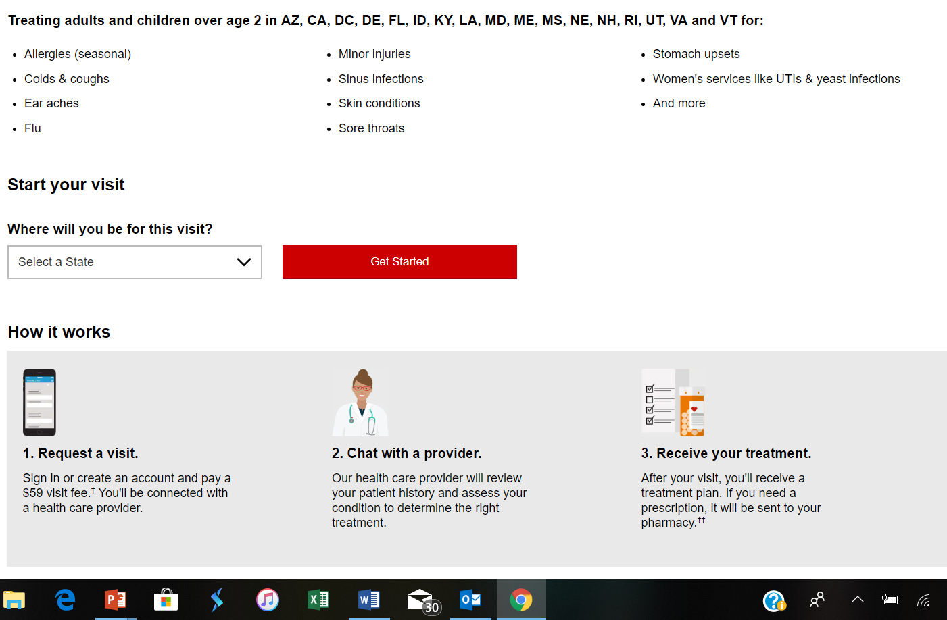
Ability to scale is one of most impressive elements.

Slide 15

Bad actors affecting more rapid expansion.
Tennessee nurse pleads guilty in $65.7M telemedicine fraud scheme
Written by Ayla Ellison (Twitter | Google+) | December 03, 2018 | Print | Email
A nurse practitioner pleaded guilty Nov. 27 to conspiracy to commit healthcare fraud for her role in a $65.7 million scheme that involved prescribing expensive compounded medications to Tricare beneficiaries, according to the Department of Justice.
As part of her guilty plea, Candace Craven, NP, admitted she conducted sham telemedicine evaluations that resulted in the prescription of the compounded medications to patients she never examined in person.
New Jersey physician arrested in $20M telemedicine fraud scheme
Written by Julie Spitzer | November 26, 2018 | Print | Email
Burlington, N.J., officials charged Bernard Ogon, MD, for his role in a $20 million telemedicine fraud scheme in which he allegedly prescribed expensive medications to patients who did not need them, according to a Nov. 16 news release.
Various unnamed telemedicine companies allegedly paid Dr. Ogon to prescribe expensive compounded medications, such as pain creams, scar creams, migraine creams and metabolic supplements, or "wellness capsules," to patients regardless of whether they were medically necessary.
Dr. Ogon reportedly signed these prescriptions without establishing any prior relationship with the patient, and without speaking with the patient or conducting a medical evaluation. He also signed prescriptions for patients in states he was not licensed to practice in.

Slide 16
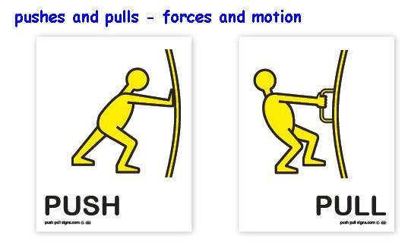
Telehealth: classic example of a disruptive technology

